Slide 1
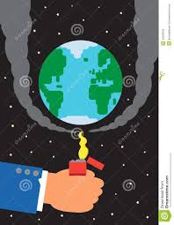
All are students welcome

Slide 2

Introduce-
Md Saidul hoque.
Asistant Teacher.
Enayetpur madrash.
Up: senbag.
Dist: Noakhali.
Class: Dakhil for class seven
Subject: English For Today
Unit: Nine
Lesson: Two.
Time: 50 m

Slide 3
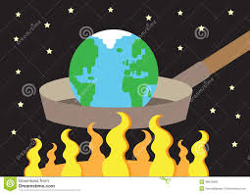
Look at the picture
What do you see here ?
Thank you.

Slide 4
Todays Lesson-
The heating up of Earth

Slide 5
Learning out come-
After we have studied this unit, we will be able to-
Read and understand text
Talk about climate and environment
Ask and answer question
Write short- guided and semi guided sentences and passages.

Slide 6
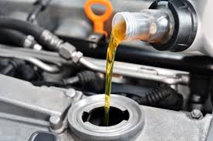
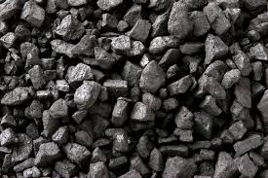
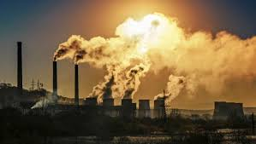
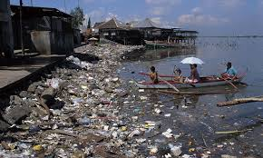
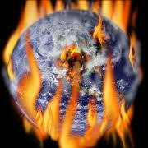
Key words:
Word and pronounciation | Picture of synonyms | Meanings in Bangla
Fuels |  | জ্বালানি
Coal |  | ক্বয়লা
Pollution |  | দুষণ
Atmosphere |  | বায়ুমণ্ডল

Slide 7
Read the passage Loudly :
The sun is getting hotter. It is also very old. It is about 4,5oo million years old |
The earth’s climate has been changing for all those years. But the climate is heating up much faster now. Humans and their machines are responsible for the rapid heating up of the earth.
Almost all machines use fuels such as oil, gas or coal. All of them produce pollution. Much of this pollution contains a gas called carbon dioxide. It is this gas which pollutes the atmosphere.

Slide 8
True or false. If false, give the correct information.
1. The earth’s climate has been changing for 4,500 million years.
Ans. True.
2. Only machines are responsible for the earths’ getting hotter.
Ans: false.Correct answer: Humans and their machines are responsible for the earths getting hotter.
3. Coal is one kind of fuel.
Ans. True.
4. Carbon dioxide gas pollutes the environment.
Ans: false
correct answer: carbon dioxide gas pollutes the atmosphere.

Slide 9
Group wark-
Make five sentences from the substitution table:
The sun
The climate of the Earth
Man
Fuels
Uses
produce
is
Pollution
About 4,500 years old
Changing very rapidly
Responsible for climate change
Fuels to run machines

Slide 10
See the answers seat:
The sun is about 4,500 years old.
The climate of the earth is changing very rapidly.
Man is responsible for climate change.
Man uses fuels to run machines.
Fuels produce pollution.

Slide 11
Evaluation:
Question:
How old is the sun about?
What’s changing for the heating up of the sun?
Who are responsible of heating up the earth?
What is heating the earth?
What is climate change?

Slide 12
Home work:
Question:
Summarize the above passage in your own words.

Slide 13

Thanks all are students

